Slide 1

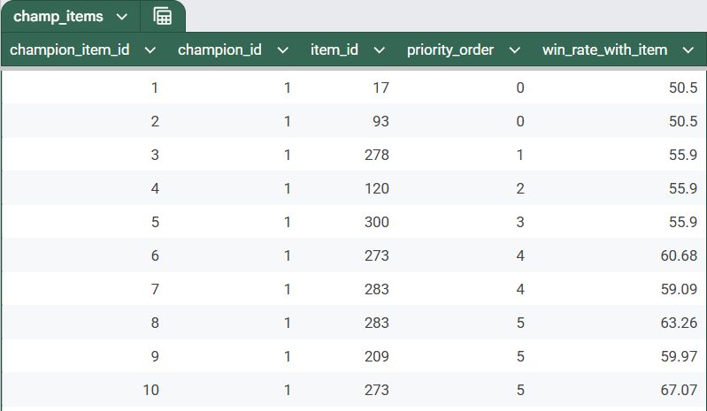
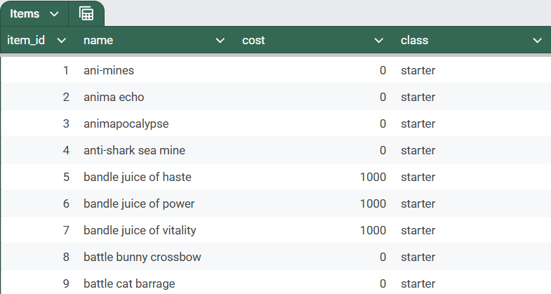
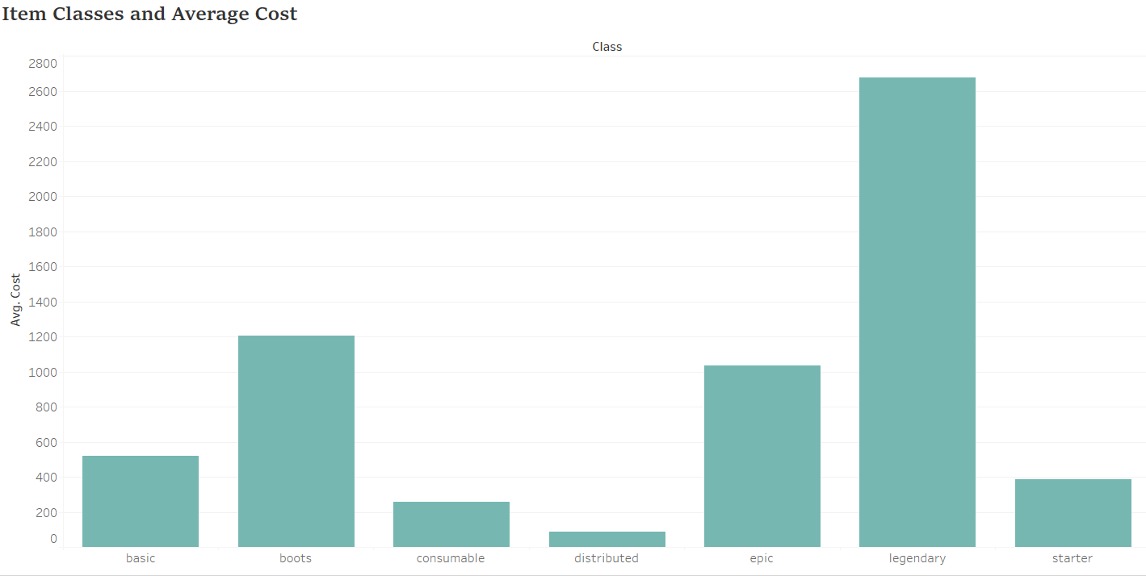
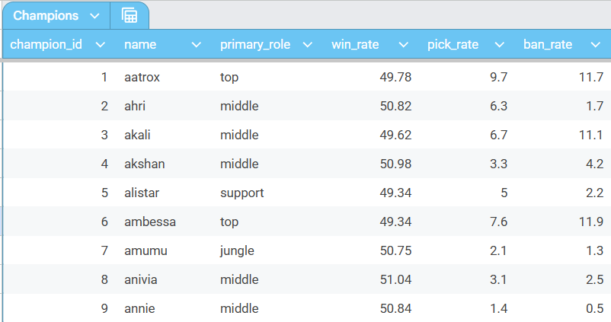
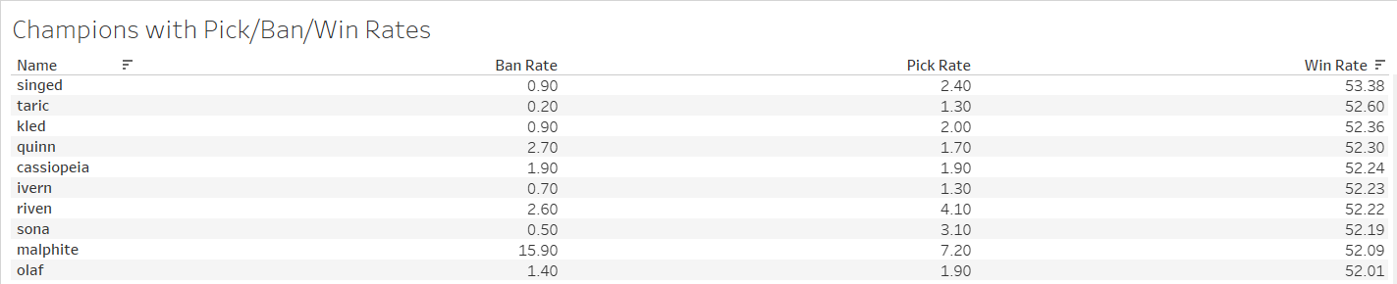
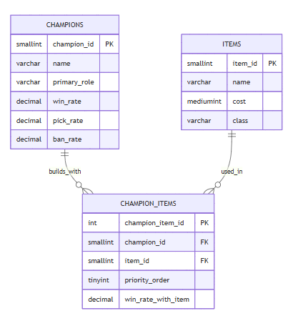
League of Legends Database
Anna Wahl | Huntington University | CS 415 Database Management – Fall 2025 - Final Project
Overview
Data
Reports
This database was created for the League of Legends competitive gaming community, specifically players who want to optimize their builds based on statistical data. League of Legends is a Multiplayer Online Battle Arena (MOBA) game where players select champions and build items throughout the match to enhance their champion's abilities. With over 170 champions and 300+ items, determining item builds can be overwhelming and confusing for players at all skill levels.
The data for this database was pulled directly from u.gg, a leading League of Legends statistics platform that aggregates millions of matches to provide win rates, pick rates, and performance metrics. This database models the relationship between champions, items, and their combined effectiveness to help players make informed decisions during champion select and in-game backing.
Design
From the user’s perspective, this database makes creating builds significantly easier. Players can quickly look up any champion, explore item options, and view recommended optimal builds.
They can also track win rates for both items and champions, allowing them to easily identify the current meta picks for each season.
By the end of each Act, the database can also generate helpful reports—such as the top-performing champions and the most effective items. Centralizing all this information in one place ensures that the data is accurate, consistent, and simple to analyze.
Queries
Query 1: Gets all champions sorted by win rate (descending) and by ban rate (ascending). This identifies the strongest champions that are not heavily banned. This is most useful for players who want to pick strong champions that will likely not be banned.
Query 2: Calculates the total cost of a full item build for the champion 'bard'. Also calculates the required gold per minute (GPM) to afford this build by 27 and 30 minutes. This helps players understand the economic requirements for building items on Bard.
Query 3: Lists the top 15 jungle champions by win rate, along with an abbreviation of their role using the MID function.
Query 4: Group items by class and calculate the average, minimum, and maximum cost for each class. Useful for newer players to understand the cost distribution of different item classes.
Query 5: Retrieves all items used by the champion 'ahri', along with their cost, priority order, and win rate when used by her. This helps players understand which items synergize best with Ahri.
Query 6: This query uses a LEFT JOIN to find the single highest win-rate item for every champion in the database, even if some champions don't have item data yet. The LEFT JOIN ensures all champions appear in the results, with NULL values for champions without build data.
Query 7: Updates the win rate and pick rate for the champion 'jinx'. This reflects recent performance changes in the game meta.
Query 8: Deletes all items from the items table that have a cost less than 200.
Query 9: Creates a view that shows champions with high win rates when using specific items. This view includes the champion name, primary role, item name, item cost, priority order, and win rate with the item. The view filters for builds with a win rate greater than 53.00%.
Query 10: This command starts a transaction, temporarily updates all champions with the top-lane role to support, and lets the user preview the changes. It then rolls back the transaction so none of the updates are saved, confirming that the original data is restored. We need to humble top laners somehow.
ER Model
Future Work
In the future, I would like to add more data to the database. Additionally, I would like to sync it to the U.GG database or add a web scraper to get the data from there automatically. My reasoning for this is that the data updates by the second, so maintaining up to date data on the various champions and items is valuable. Additionally, I would like to add other information, such as matchups. Another idea could be creating a dashboard for this project. There is so much that this project could expand to.
Works Cited
“U Gg: The Best League of Legends Builds Lol Build Champion Probuilds Lol Runes Tier List Counters Guides.” U GG: The Best League of Legends Builds LoL Build Champion Probuilds LoL Runes Tier List Counters Guides, u.gg/. Accessed 06 Dec. 2025.

